Slide 1

TensorFlow 2.0
PRACTICAL

Slide 2
COURSE OUTLINE

Slide 3

AGENDA
BEST PRACTICES
HOW TO DOWNLOAD THE COURSE MATERIAL
HOW TO GET HELP/ASK QUESTIONS
HOW TO SUCCEED IN THIS COURSE?
HOW TO GET CERTIFICATE?
TensorFlow 2.0 PRACTICAL

Slide 4
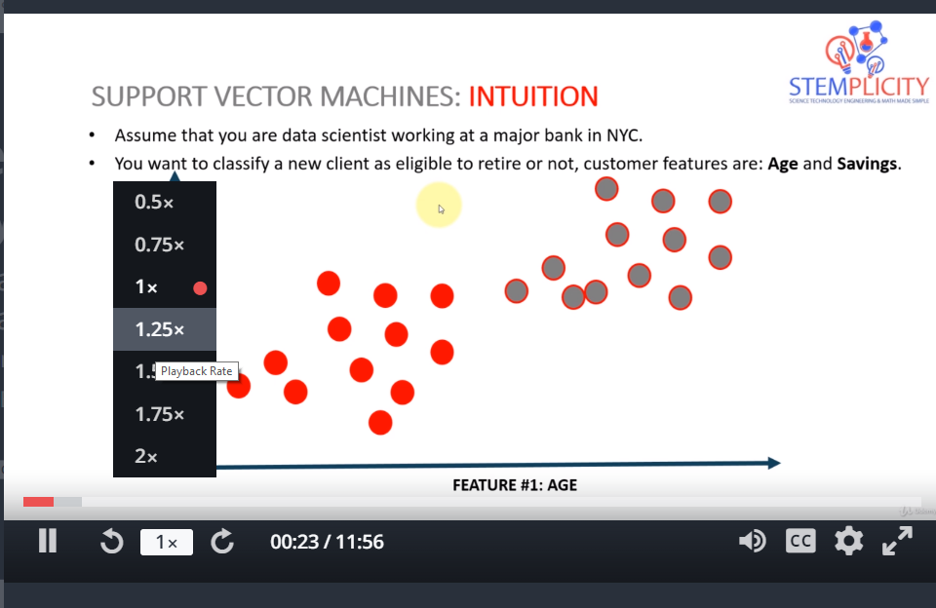
BEST PRACTICES: CHANGE VIDEO SPEEDS
You have the option to play the lectures at different speeds: (.5x, 1x, 1.25x, 1.5x or 2x)
In the bottom-left corner of the video, you can select change the speed of the video.
TensorFlow 2.0 PRACTICAL

Slide 5
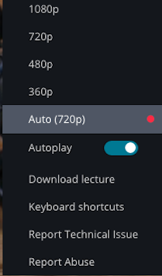
BEST PRACTICES: CHANGE THE VIDEO PLAYBACK QUALITY
Udemy automatically optimizes video resolution based on your internet connection speed.
Alternatively, you can select resolutions of 360p, 480p, 720p and 1080p for the video quality.
All course lectures are filmed with HD quality 1080p.
TensorFlow 2.0 PRACTICAL

Slide 6
BEST PRACTICES: HOW TO REACH OUT FOR HELP WITH UDEMY PLATFORM ISSUES?
No control over platform issues
If encounter any platform problems, please e-mail support at:
support@udemy.com
TensorFlow 2.0 PRACTICAL

Slide 7
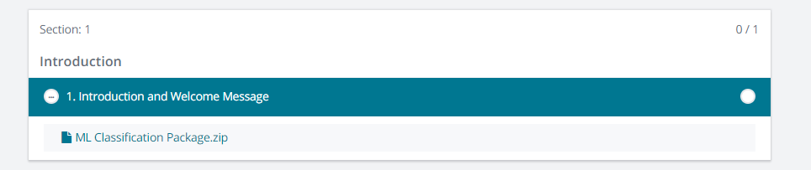
HOW TO DOWNLOAD THE COURSE MATERIALS?
In the introduction section, you will find a zipped file that contains all slides.
A link to the Google Colab notebooks will be available with every project.
TensorFlow 2.0 Practical.zip
COURSE MATERIAL, DOWNLOAD AND UNZIP
TensorFlow 2.0 PRACTICAL

Slide 8
HOW TO GET HELP/ASK QUESTIONS
Step#1: Check the lecture videos for answers
Step#2: Search the previous Q&A
Step#3: Search StackOverflow for error messages
Step#4: Post in Q&A and our team will be happy to help you out
NOTE: PLEASE INCLUDE A SCREENSHOT OF THE ERROR AND LECTURE NUMBER
TensorFlow 2.0 PRACTICAL

Slide 9
HOW TO SUCCEED IN THIS COURSE? WRITE THE CODE OR RUN COLAB NOTEBOOKS?
For the Projects:
Step #1: Run the Google Colab notebook first. Make sure everything is running well.
Step #2: Start a blank Colab notebook and code along with me while watching the videos.
For Mini Challenges:
Step #1: Attempt to solve the challenge on your own.
Step #2: Compare your answers with solutions notebook while watching the solutions video lecture.
TensorFlow 2.0 PRACTICAL

Slide 10
HOW TO GET CERTIFICATE OF COMPLETION?
When you complete this course, you will receive a certificate of completion.
You can share with co-workers and potential employers.
When all curriculum items of have been completed, a red or white trophy will appear on the course dashboard, indicating that the certificate of completion is ready.
More information:
https://support.udemy.com/hc/en-us/articles/229603868-Certificate-of-Completion
TensorFlow 2.0 PRACTICAL

